Slide 1



Consumer Goods Ad_Hoc Insights
Presented by Nidhi Jain

Slide 2



Project analysis slide 2
AGENDA
Company Overview
Conclusion
AtliQ Hardware
Objective
About Data
Requests, Queries, and Insights

Slide 3
Project analysis slide 11
Company Overview
Our Company
Atliq Hardware is one of the leading computer hardware producers in India as well as 26 other countries across the globe
Manufactures products under 3 major divisions i.e., Peripherals & Accessories, PC, Networking & Storage
We have a total of 74 Customers like Neptune, Sage, Leader, Vijay Sales etc. across all markets/countries

Slide 4
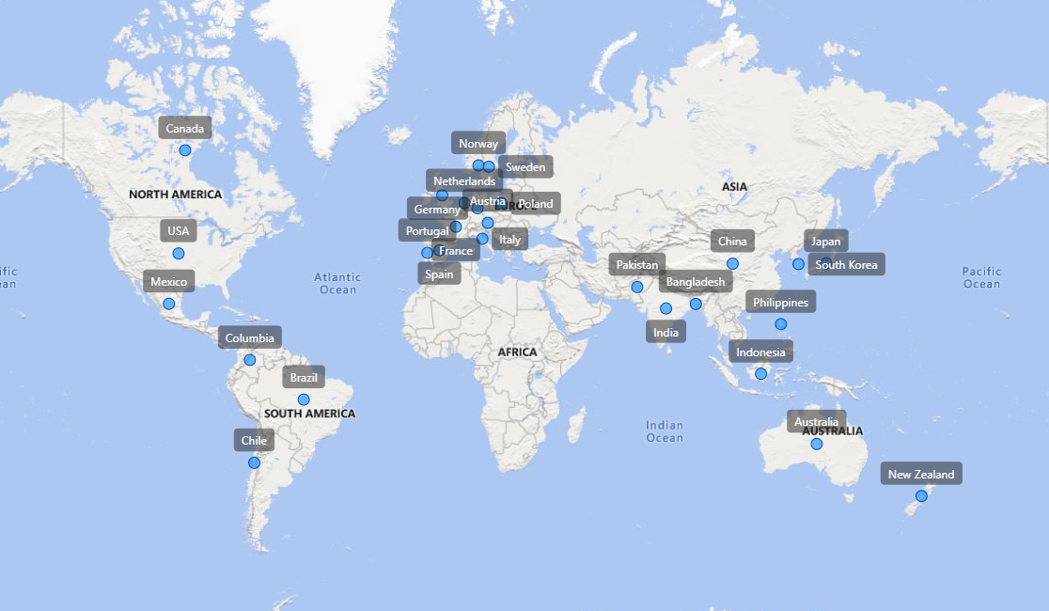
Project analysis slide 11
Company’s Market

Slide 5
Project analysis slide 11
Atliq’s Product lines
PC
Desktop
Business Laptop
Personal Laptop
Notebook
Gaming Laptop
Business Laptop
Personal Laptop
P & A
Peripherals
Internal HDD
Graphic Card
Processors
Mother Board
Accessories
Mouse
Keyboard
Batteries
N & S
Storage
External SSD
USB Flash drives
Networking
Wi Fi Extender

Slide 6
Project analysis slide 11
Objective
Provide actionable insights to the management team using available sales and operations data.
Enable data-driven decision-making for market expansion and product development.
Identify high-performing and underperforming segments to optimize resource allocation.

Slide 7
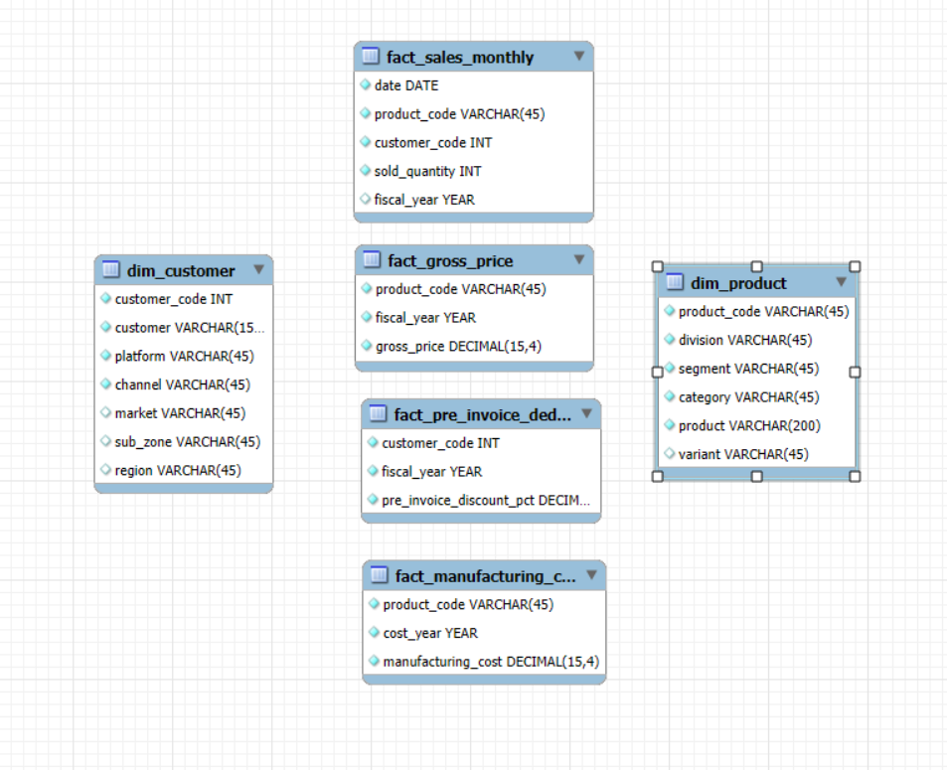
Project analysis slide 11
About Data
The analysis is based on multiple fact and dimension tables from Atliq Hardware's database.
Fact Tables:
fact_sales_monthly – monthly sales quantity
fact_manufacturing_cost – cost of manufacturing products fact_pre_invoice_deductions – discounts before invoicing fact_gross_price – product pricing before deductions
Dimension Tables:
dim_customer – customer details (market, region, channel)
dim_product – product details (division, segment, category)
Fiscal Year: September 1 to August 31
Data Availability: FY 2020 & FY 2021
Coverage: 27 countries across NA, EU, APAC regions

Slide 8
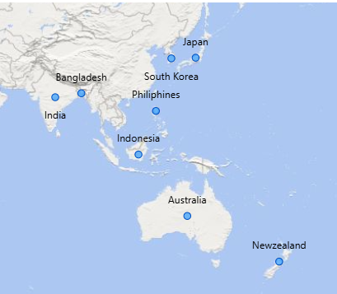
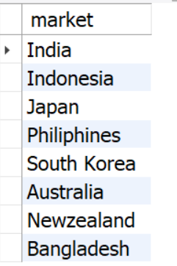
Project analysis slide 11
Request 1
Provide the list of markets in which customer "Atliq Exclusive" operates its business in the APAC
Query:
SELECT DISTINCT(market) FROM dim_customer
WHERE customer = 'Atliq Exclusive'
AND region = 'APAC';
Output:
Insights:
Atliq Exclusive operates in 8 markets within APAC.
Highest presence in APAC, followed by EU (6) and NA (2).
Indicates strong regional penetration in Asia Pacific with potential for deeper market-specific strategies.

Slide 9
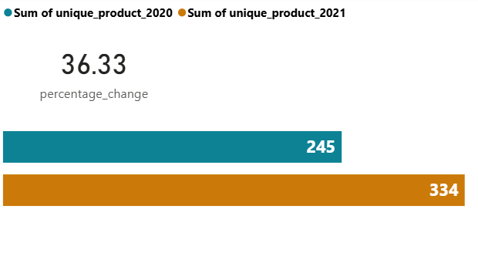
Project analysis slide 11
Request 2
What is the percentage of unique product increase in 2021 vs. 2020? The final output contains these fields: unique_products_2020, unique_products_2021, percentage_chg
Query:
with cte1 as(select count(distinct product_code) as unique_products_2020 from fact_sales_monthly where fiscal_year="2020"), cte2 as(select count(distinct product_code) as unique_products_2021 from fact_sales_monthly where fiscal_year="2021") select *,round((unique_products_2021 - unique_products_2020)*100/unique_products_2020,2) as percentage_cngfrom cte1 , cte2;
Insights:
This growth reflects the company’s ability to adapt to evolving customer demands and capture emerging market trends.
With a 36.33% increase in unique products from 2020 to 2021, Atliq Hardware is expanding its product variety at a healthy pace.
Output:

Slide 10
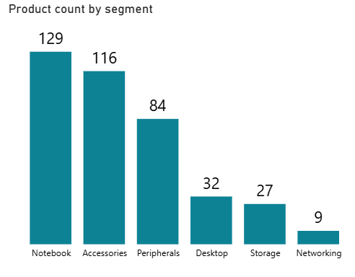
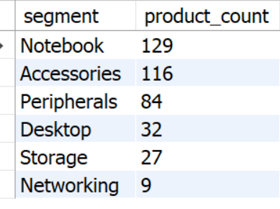
Project analysis slide 11
Request 3
Provide a report with the unique product counts for each segment, sorted in descending order by product count.
Query:
select segment, count( distinct product_code) as product_count from dim_product group by segment order by product_count desc;
Output:
Insights:
Notebook, Accessories, and Peripherals lead in product variety, averaging around 110 products each.
Desktop, Storage, and Networking segments lag behind, with fewer than 25 unique products each.
The Product Development team should evaluate underperforming segments for redesign or innovation opportunities to stay competitive.

Slide 11
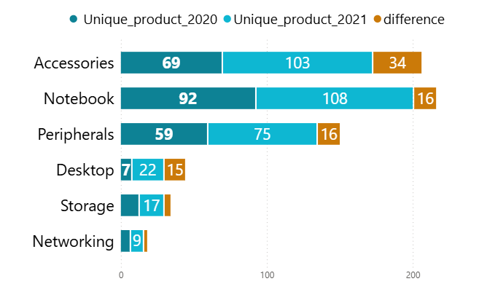
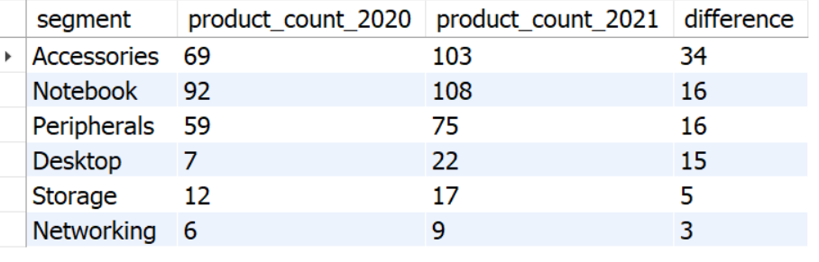
Project analysis slide 11
Request 4
Which segment had the most increase in unique products in 2021 vs 2020? The final output contains these fields:segment, product_count_2020, product_count_2021, difference.
Query:
WITH unique_product AS (
SELECT
b.segment AS segment,
COUNT(DISTINCT CASE WHEN fiscal_year = 2020
THEN a.product_code END) AS product_count_2020,
COUNT(DISTINCT CASE WHEN fiscal_year = 2021
THEN a.product_code END) AS product_count_2021
FROM fact_sales_monthly AS a
INNER JOIN dim_product AS b
ON a.product_code = b.product_code
GROUP BY b.segment
)
SELECT
segment,
product_count_2020,
product_count_2021,
(product_count_2021 - product_count_2020) AS difference
FROM unique_product
ORDER BY difference DESC;
Insights:
Notebook and Peripherals each added 16 new products, sustaining their high product variety.
Accessories segment leads with 34 new products, showing strong innovation focus.
Output:

Slide 12
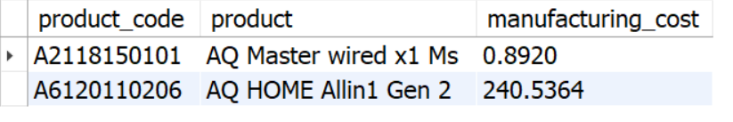
Project analysis slide 11
Request 5
Get the products that have the highest and lowest manufacturing costs.The final output should contain: product_code, product, manufacturing_cost.
Query:
Output:
select p.product_code,p.product,m.manufacturing_cost
from dim_product p join fact_manufacturing_cost m using(product_code) where manufacturing_cost in ((select max(manufacturing_cost) from fact_manufacturing_cost), (select min(manufacturing_cost) from fact_manufacturing_cost));
Insights:
Highest manufacturing cost: AQ HOME Allin1 Gen 2 (Plus 3) – $240.54 (Desktop category).
Lowest manufacturing cost: AQ Master wired x1 Ms – $0.89 (Mouse category).

Slide 13
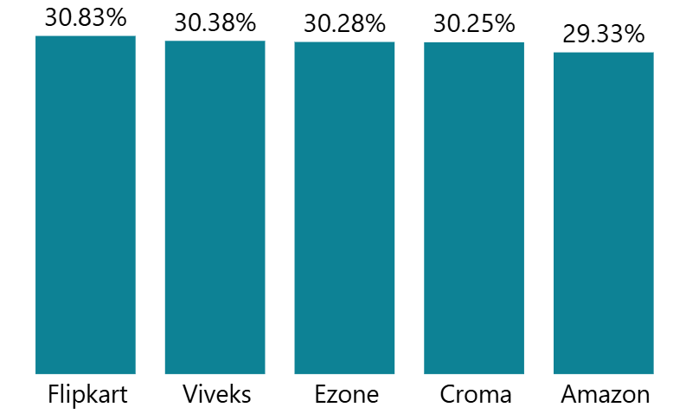
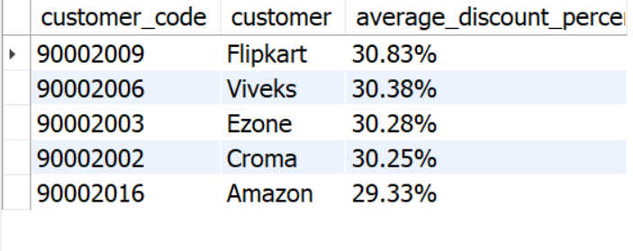
Project analysis slide 11
Request 6
Generate a report of the top 5 customers who received the highest average pre_invoice_discount_pct for the fiscal year 2021 in the Indian market.The final output should contain: customer_code, customer, average_discount_percentage.
Query:
SELECT
a.customer_code,
b.customer,
CONCAT(ROUND(AVG(pre_invoice_discount_pct) * 100, 2), '%')
AS average_discount_percentage
FROM fact_pre_invoice_deductions AS a
INNER JOIN dim_customer AS b
ON a.customer_code = b.customer_code
WHERE market = 'India'
AND fiscal_year = 2021
GROUP BY customer, customer_code
ORDER BY AVG(pre_invoice_discount_pct) DESC
LIMIT 5;
Insights:
Output:
Flipkart tops the list with 30.83% average pre-invoice discount in FY 2021.
The top 5 customers in India received an average discount of ~30.21%, significantly higher than the overall market average of 24.16%.
High discount rates for top retailers may indicate strategic partnerships or competitive pricing pressures in the Indian market.

Slide 14
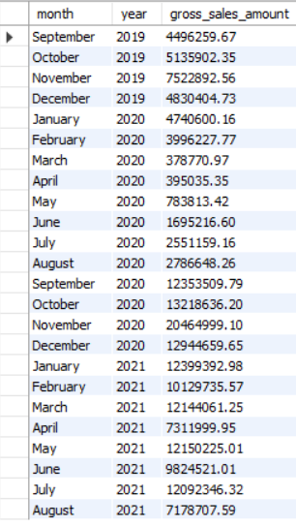
Project analysis slide 11
Request 7
Get the complete report of the Gross sales amount for the customer “Atliq Exclusive” for each month.This analysis helps identify low and high-performing months for strategic decisions.
Query:
Output:
select monthname(date) as month, year(date) as year ,round(sum(gross_price*sold_quantity),2) as gross_sales_amount from fact_sales_monthly join fact_gross_price using(product_code,fiscal_year) join dim_customer using(customer_code) where customer="Atliq Exclusive"group by month,year;
Insights:
November 2020 recorded the highest sales at $20.46M.
March 2021 had the lowest sales at $0.38M, mainly due to pandemic-related store closures.
Sales began recovering from September 2020 onwards, boosted by festival season and relaxed lockdown restrictions.

Slide 15
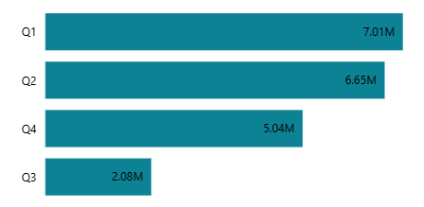
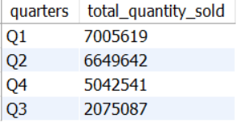
Project analysis slide 11
Request 8
Which quarter of 2020 had the maximum total_sold_quantity? The final output should contain: quarter, total_sold_quantity.
Query:
SELECT CASE WHEN MONTH(date) IN (9,10,11) THEN 'Q1' WHEN MONTH(date) IN (12,1,2) THEN 'Q2' WHEN MONTH(date) IN (3,4,5) THEN 'Q3' ELSE 'Q4’ END AS quarters, SUM(sold_quantity) AS total_quantity_sold FROM fact_sales_monthly WHERE fiscal_year = 2020 GROUP BY quarters ORDER BY total_quantity_sold DESC;
Output:
Insights:
In FY 2020, Q1 achieved the highest sold quantity, exceeding 7 million units.
Sold quantities declined in Q2 and Q3 but rebounded in Q4, reaching 5.04 million units

Slide 16
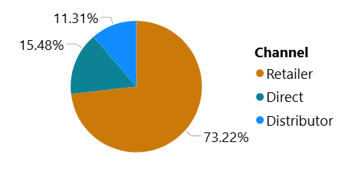
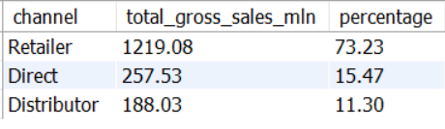
Project analysis slide 11
Request 10
Which channel contributed the most to gross sales in fiscal year 2021,and what was its percentage contribution?The final output should contain: channel, gross_sales_mln,
Query:
with cte as( select c.channel, round(sum(fm.sold_quantity*fg.gross_price)/1000000,2) as total_gross_sales_mln from fact_sales_monthly fm join fact_gross_price fg using(product_code,fiscal_year) join dim_customer c on c.customer_code=fm.customer_code where fm.fiscal_year="2021“ group by c.channel) select channel, total_gross_sales_mln, round(total_gross_sales_mln*100/sum(total_gross_sales_mln)over(),2) as percentage from cte order by percentage desc;
Insights:
Output:
Retailer channel dominates with 73.05% of total gross sales in FY 2021.
Direct and Distributor channels combined account for ~27% of sales.

Slide 17
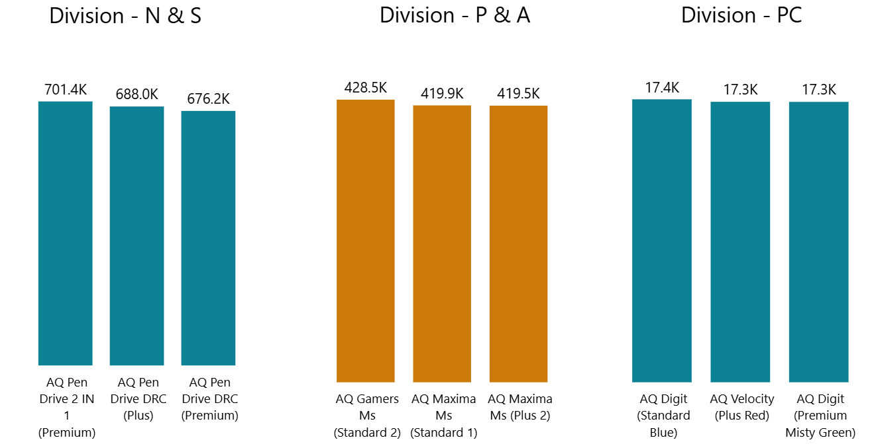
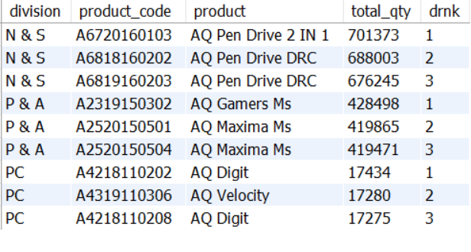
Project analysis slide 11
Request 9
Get the top 3 products in each division based on total_sold_quantity in FY 2021.The final output should contain: division, product_code, product, total_sold_quantity.
,
Query:
with cte1 as( select p.division, p.product_code, p.product, (sold_quantity) as total_qty from fact_sales_monthly s join dim_product p on p.product_code=s.product_code where fiscal_year=2021 group by p.division, p.product_code,p.product) ,cte2 as (select *, dense_rank() over (partition by division order by total_qty desc) as drnk from cte1) select * from cte2 where drnk<=3
Output:
Insights:
In the N & S division, pen drives hold the top three positions, highlighting their popularity and strong sales performance.
The P & A division features only mouse among its top three products, indicating a distinct demand for these devices.
The PC division ' s top sellers consist entirely of personal laptops.

Slide 18
Project analysis slide 11
Summary
Market Trends: Product variety grew 36.33% YoY, reflecting adaptability to evolving customer needs.
Regional Insights: Certain markets (e.g., India) show strong discount usage; regional promotions can drive growth.
Seasonality: Sales volumes peak in Q4 FY2020 and Q4 FY2021, aligning with festive and promotional seasons.
Channel Performance: Retailer channel dominates, contributing 73.05% of gross sales in FY2021.
Customer Focus: High-value customers (e.g., Atliq Exclusive) show distinct monthly sales patterns with seasonal spikes.
Product Leaders: Top products vary by division; DENSE_RANK() analysis highlights multiple SKUs tied in performance.

Slide 19
Project analysis slide 11
Recommendations
Boost Online Channel Presence
Develop targeted e-commerce strategies to increase online sales share (currently <1%)
Partner with online marketplaces for exclusive launches.
Leverage Seasonal Demand
Increase inventory and marketing spend in Q4 to align with festive peaks.
Launch flash sales in high-performing months to maximize revenue.
Optimize Discounts by Region
Analyze discount elasticity in high-discount markets (e.g., India) to avoid margin erosion.
Tailor promotions to regional buying patterns.
Focus on Top Products
Bundle top-performing SKUs (from DENSE_RANK() analysis) with complementary items.
Maintain high stock levels of bestsellers during demand peaks.
Channel Diversification
Explore Direct-to-Consumer (D2C) models for better margins.
Train retailer partners for upselling and cross-selling high-value products.

Slide 20
Thank You

